Slide 1
HTML

Slide 2


Slide 3
OVERVIEW

Slide 4
OVERVIEW
A brief history of HTML.
The syntax of HTML.
Why semantic structure is important for HTML.
How HTML documents are structured.
A tour of the main elements in HTML.
The semantic structure elements in HTML.
https://www.w3schools.com/html/default.asp

Slide 5
BACKGROUND
The development of HTML was relatively clouded ever since the 1960s, but began to standardize in 1993 by W3C.
The statement essentially wrote that to publish information for global distribution, a universally understood language was required, which came to be HTML.
HTML is defined as a markup language. A markup language allows users to control how text and visual elements are laid out on a document.
Markup language uses content and tags to display information on a page. The content is the text in it’s raw state and the tags adds the formatting.

Slide 6

REFERENCE
HTML changes all the time and an excellent documentation reference is the W3Schools at https://www.w3schools.com/html/default.asp.
This reference is one of the best sources of truths on updated HTML, other sites like stackoverflow or geeksforgeeks are secondary sources.
Only use this slide deck as an introduction to the fundamentals to HTML, but use the w3schools link as the true reference when doing development.

Slide 7
XHTML
XHTML was a stricter version of HTML developed by W3C in the 1990s to provide better long-term results in web development.
Web browsers were relatively lenient in the 1990s, allowing sloppy HTML with syntax errors. This caused browsers to be unpredictable when handling errors.
The goal of XHTML was to have strict rules on page rendering by forcing web masters to create pages without errors.
The 2 versions of XHTML that were created were XHTML 1.0 Strict and XHTML 1.0 Transitional. The transitional version was more lenient.

Slide 8
HTML VS XHTML, IN XHTML…
<!DOCTYPE> is mandatory.
The xhtml attribute in <html> is mandatory.
<html>, <head>, <title>, and <body> are mandatory.
Elements must always be properly nested.
Elements must always be closed.
Elements are recommended to be in lowercase.
Attributes are recommended to be in lowercase.
Attribute values must always be quoted.
Attribute minimization is forbidden.

Slide 9
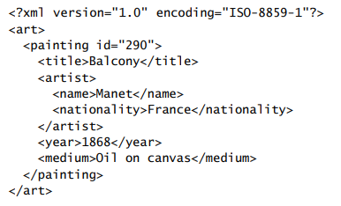
XML
Similar to HTML, XML is also a markup language set by W3C.
XML is liter weight and more general than HTML. It’s used to mark up any data such as schemas, file format documents, and rss data.
The rules of XML are that there is a single root element, tag names are composed of any valid characters, tag names do not start with a number, tag names and attributes are case sensitive, attributes must be within quotes, and all tags must have a closing tag.

Slide 10
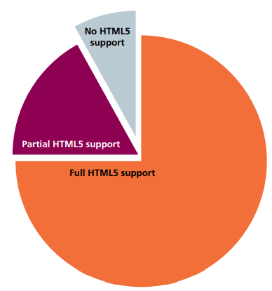
HTML5
Developers at Opera and Mozilla formed the web hypertext application technology working group(WHATWG) because they thought it was an improvement to the W3C’s XML standard.
WHATWG focused less on semantics but more on the web.
By 2009, the W3C stopped work on XHTML 2.0 and adopted the work done by WHATWG and named it HTML5.
The main improvements were:
Invalid markup management.
Provide a framework for creating rich web applications.
Backwards compatibility.

Slide 11
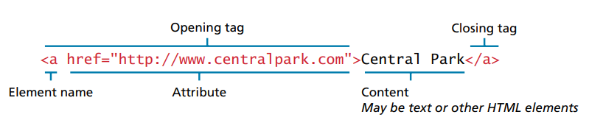
FULL ELEMENT SYNTAX
HTML syntax dates back to 1999, centered around content, tags, and attributes.
Content is wrapped in tags, that contain attributes, as shown below.
Attributes are name value pairs that specifies information about the tag. The value must be wrapped in quotes.

Slide 12
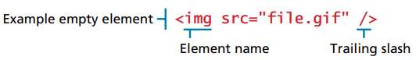
EMPTY ELEMENT SYNTAX
HTML also supports empty elements. These elements do not contain any text inside.
An empty element is defined with a trailing slash.
The most common empty element is the image tag.

Slide 13
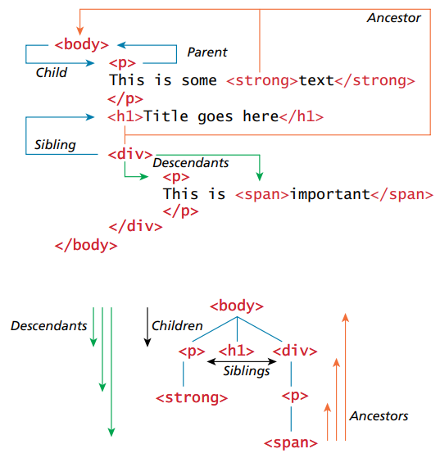
NESTING HTML ELEMENTS
It’s very common to nest html elements on top of each other in a parent child relationship.
Any element contained within a child is said to be a descendant of a parent element. Likewise any child element may have a variety of ancestors.
This hierarchy of elements is called the document object model (DOM).

Slide 14
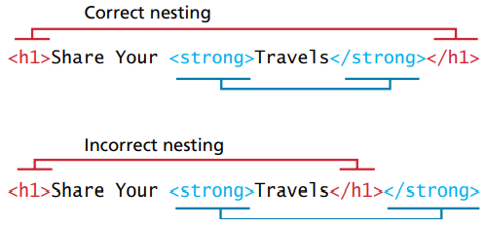
NESTING HTML ELEMENTS
To properly construct this hierarchy of elements, your browser expects each HTML element to be properly nested.
If the tags are not wrapped properly, the page will not render properly.

Slide 15
BASICS

Slide 16
TAGS
Over the years of development, a consensus has grown with the belief that HTML should only focus on the structure of the document, not on the style.
The style should be focused with a separate language, cascading style sheets (CSS).
Semantic markup focuses on the hierarchy and structure of an HTML document more than the style.
Semantic markup improves maintainability, it is faster, it is accessible, and it optimizes search engines.
Semantics are structured with HTML tags. Each tag has it’s own function and there are over 142 tags of them.
Some tags can not go on other tags.

Slide 17
ATTRIBUTES
Attributes are specifications that can be added to each HTML tag so they behave certain ways.
Some of these attributes can also be done using CSS.
W3C recommends that all attributes be written in lower case and values be quoted.

Slide 18


ATTRIBUTES
Attributes are specifications that can be added to each HTML tag so they behave certain ways.
Some of these attributes can also be done using CSS.
W3C recommends that all attributes be written in lower case and values be quoted.

Slide 19
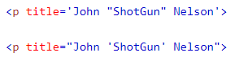
ATTRIBUTES
Quotes are required to define values on attributes.
Single and double quotes can be used interchangeably to display actual quotes vs defining attribute values.

Slide 20
ATTRIBUTES
The ‘style’ attribute is the most common one. It allows CSS to be injected in-line directly on the tag, as opposed to using a class and stylesheet.
The ‘lang’ attribute is used on the html tag to define the language on browsers.
The ‘href’ attribute can be used by the anchor tag to define the website the hyperlink navigates to.
The ‘src’ attribute can be used by the img tag to define the location of the image that displays.
The ‘width’ and ‘height’ attributes can be used to define the sizes of an image.
The ‘alt’ attribute displays a backup message in case the image can not be displayed.
The ‘title’ attribute is used to add a tooltip on any given tag.

Slide 21
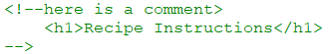
COMMENTS
Comments in HTML are opened with ‘<!--’ and closed with ‘-->’.
A comment is important for readability, and should always be included on top of a section of code.
Comments can describe the business case of a scope of code, it can serve as a summary header, or as a warning to the developer.

Slide 22
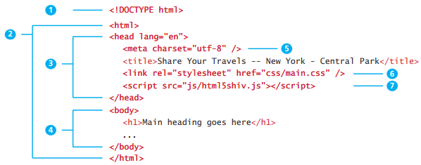
DOCTYPE
The document type definition (DOCTYPE) tells the browser the type of document to process.

Slide 23
HEAD AND BODY
HTML5 does not require the <html>, <head>, and <body> tags but XHTML requires them.
The <html> tag is sometimes called the root because it wraps all other tags in the document but is mainly divided between the head and body tags.
The head contains content about the document, such as title, style sheets, and JavaScript files.
The body contains content that will be displayed by the browser.

Slide 24
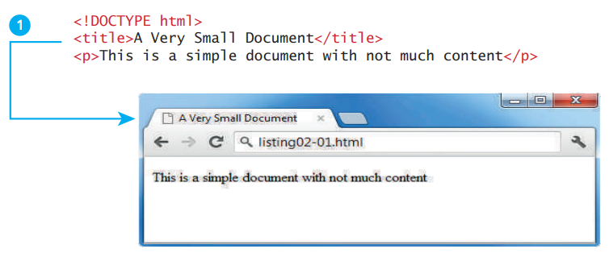
TITLE TAG
HTML documents are structured with a series of tags.
The <title> tag is used to display the label of a page.
The browser uses the title tag for its bookmarks and browser history.
The operating system might also use it for the windows taskbar.
Search engines use the title tag as the linked text to their search engine result pages.

Slide 25
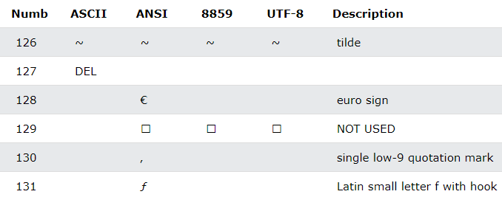
CHARSETS
Charsets aka character sets are used by web browsers to know which character encoder should be used to display the page properly.
There are many charsets out there such as ASCII, ANSI, 8859, and UTF-8.
Although most of them use the same codes, there are still some that are different. That is why it is important to define the right charset on every webpage.

Slide 26
FILE IMPORTS
The meta tag is used to contain information about the page like the encoder.
Specifies the external CSS sheet that used in the document.
Specifies an external JavaScript file.

Slide 27
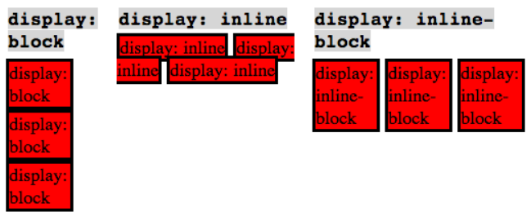
BLOCK + INLINE
Block elements carriage-return on each tag.
Inline elements stay on the same line.

Slide 28
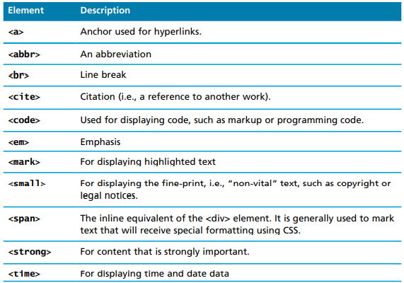
INLINE ELEMENTS
Inline text elements such as <strong>, <time>, and <small> are called inline because they do not disrupt the flow of text. They don’t add carriage-returns and white space.
A list of common inline elements are shown.

Slide 29
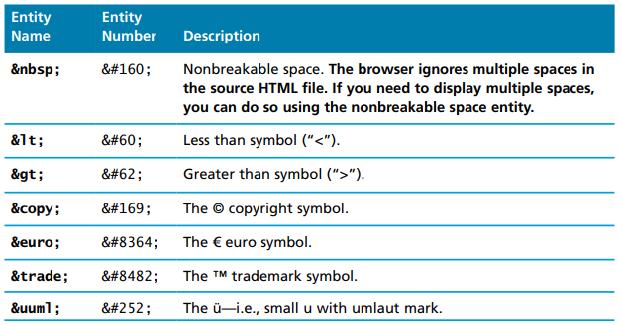
ENTITIES
Character entities are used for characters that are not easy to type with a keyboard, or have a reserved meaning, or have reserved functions, like the non-breakable space.
A list of common character entities are shown.
The &lt; and &gt; is highly encouraged because otherwise if </ is used on a value, it can cause the browser to confuse it for a tag and render incorrectly.

Slide 30
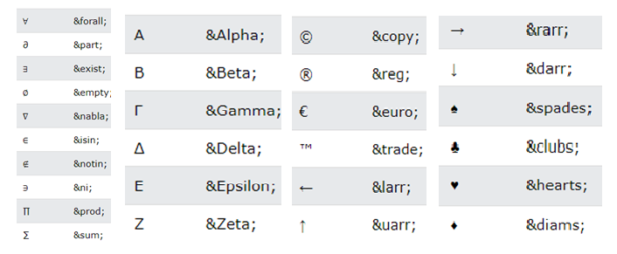
ENTITIES

Slide 31
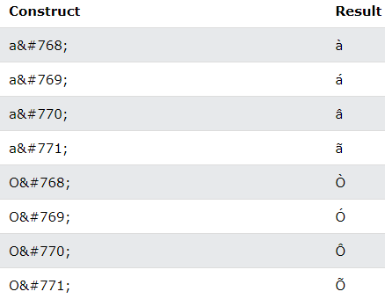
DIACRITICALS

Slide 32
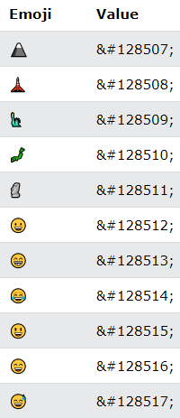
EMOJIS
Emojis look like images and icons but they are not, they are letters from the UTF-8 character set <meta charset="UTF-8">.
Emojis are good for expressing emotions on the internet. Confrontations can sometimes occur if the wrong tone is expressed without an emoji.
The full list can be found here https://www.w3schools.com/charsets/ref_emoji.asp

Slide 33
TAGS

Slide 34
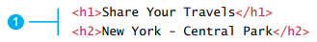
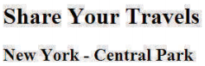
H TAGS
Heading tags (h1, h2, h3…) are used to display different sized text.
These tags are not used often anymore because their format can be replaced with CSS.
Using these sorts of default h tags can sometimes be hard to work with, because they contain hidden margins and spaces that are hard to control.

Slide 35
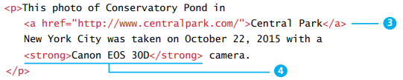
P TAGS
The <p> tag is wrapped around text to define a paragraph.
The <br/> tag is used by itself and used to force a line break.

Slide 36
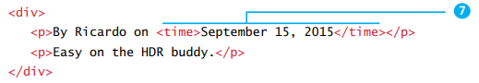
DIV + SPAN TAGS
The <div> tag and the <span> tag are the most common HTML tags, and are used as generic containers for anything.
The <span> tag is usually preferred because it is inline and liter weight than the div tag. The <div> tag is block-level.

Slide 37
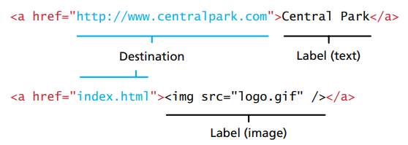
A TAGS
The <a> tag aka the anchor tag is used to define a hyperlink, so that when a user clicks on it, it loads a link.
Links can be to external sites, to other pages, to other locations within the current page, to start an email service, or to execute a JavaScript function.
In older sites, the term ‘click here’ was used on hyperlinks. Nowadays this is obsolete, because buttons are not always triggered by clicks and buttons should describe more about the function.
To force a link into a new tab, you can use the target=“_blank” syntax.
When first testing an anchor tag, it is common to set the href as href=‘#’. The browser will recognize them as links, but nothing will happen when the link is clicked.

Slide 38
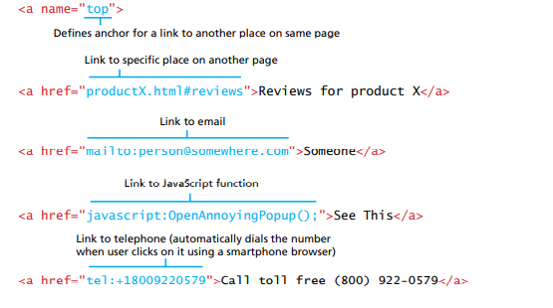
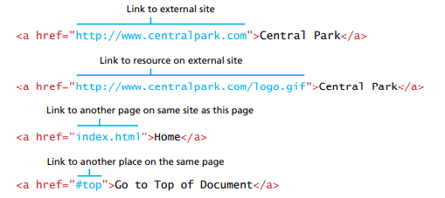
A TAGS

Slide 39
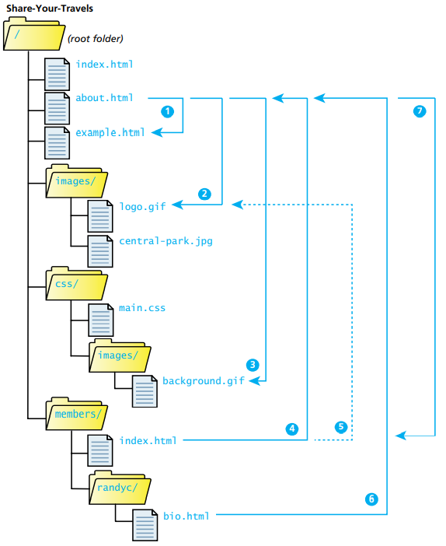
PATHS
File locations are specified using path names of directory trees.
The “/” symbol is used to split folder directories within a pathname.
The “..” symbol is used to move 1 folder up in the tree.

Slide 40
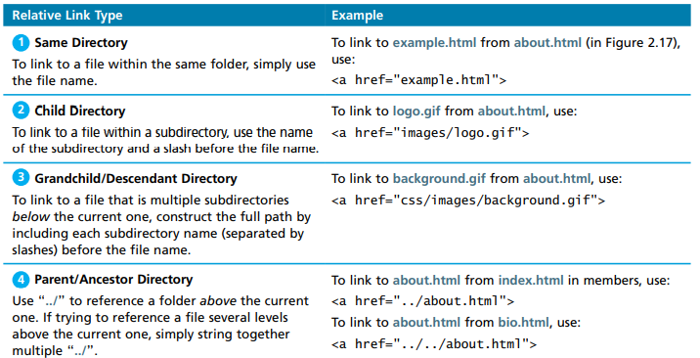
PATH EXAMPLES

Slide 41
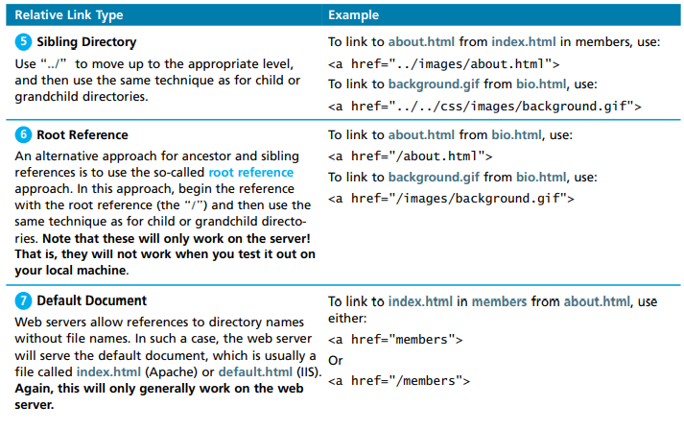
PATH EXAMPLES

Slide 42
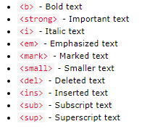
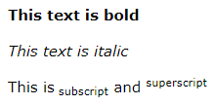
FORMATTING
Formatting is used to format HTML without using CSS.
The <font color=‘red’> tag is an example method of turning font red without using any CSS, or the <u> tag is used to underline.

Slide 43
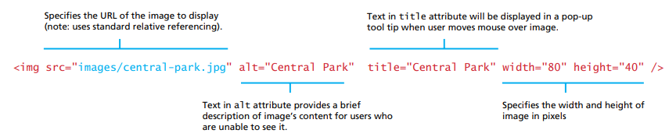
IMAGES
The most common way to display an image is by using <img>.
Other ways include using the background-image property using css.

Slide 44
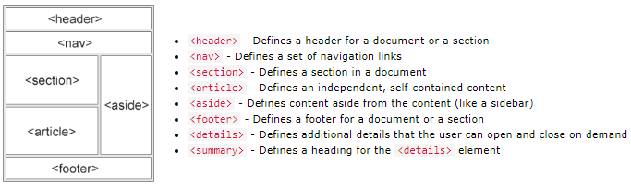
LAYOUT

Slide 45
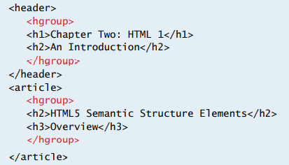
HEADING GROUPS
The <hgroup> tag can be used to group elements together.
It can only contain <h> elements.
In 2013, the W3C decided to drop the <hgroup> element and encouraged people to use <div> tags instead to group headers.

Slide 46
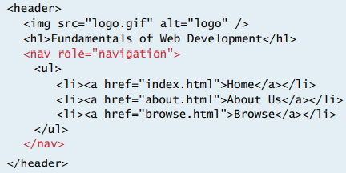
NAVIGATION
The <nav> element is used to navigate to other parts of a page.
They are commonly used on page tabs.

Slide 47
ARTICLES AND SECTIONS
To make a book easier to read, it is broken up into chapters and sections.
In HTML, the same is done with <article> and <section> tags.
However, nowadays those tags are not used often, because sectioning is mainly handled with <div> since they are more universal.

Slide 48
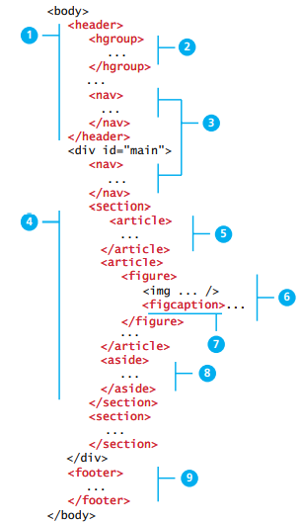
HEADERS AND FOOTERS
It is common for websites to have headers and footers.
Headers will typically contain the site logo and title, navigation links, and a banner.
The footer contains less important information at smaller font, such as twitter feeds or links to other social sites, copyright notices, information on site privacy.

Slide 49
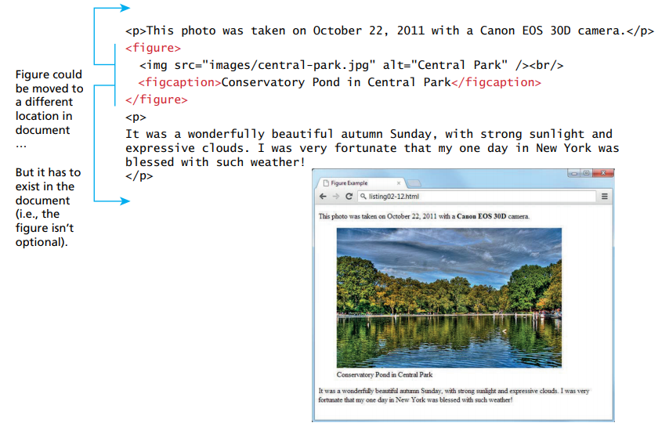
FIGURES
Figures can be added using the <figure> tag.
A figure caption can be added using the <figcaption> tag.

Slide 50
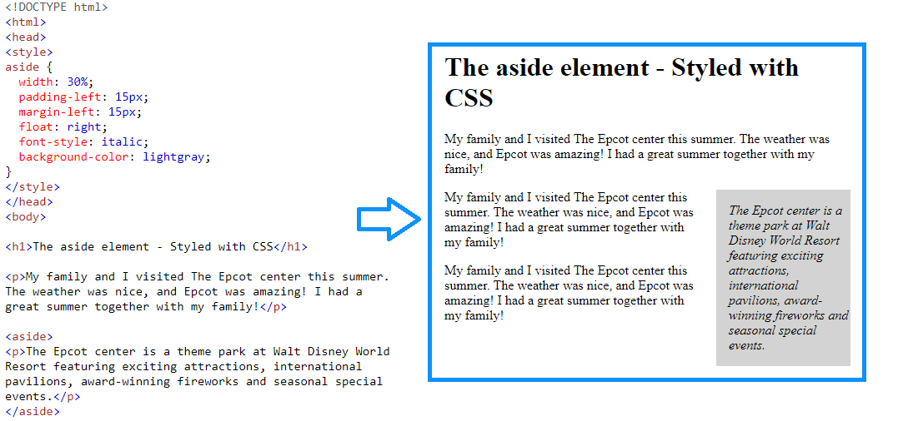
ASIDES
The <aside> tag does not render as anything, but can be used with css to render side notes.

Slide 51
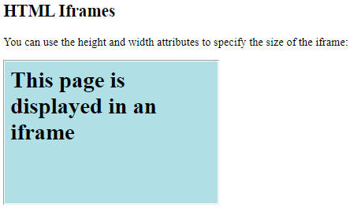
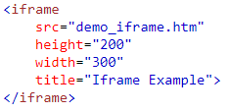
IFRAMES
The <iframe> tag is used to display a web page inside another web page.
They are useful for advertisements on web pages, because they give isolated third party security and scripting.

Slide 52
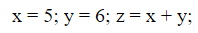
OTHER TAGS
The <hr> tag creates a line across the page.
The <code> tag displays the content in a programming font.
Without code tag:
With code tag:

Slide 53
STRUCTURES

Slide 54
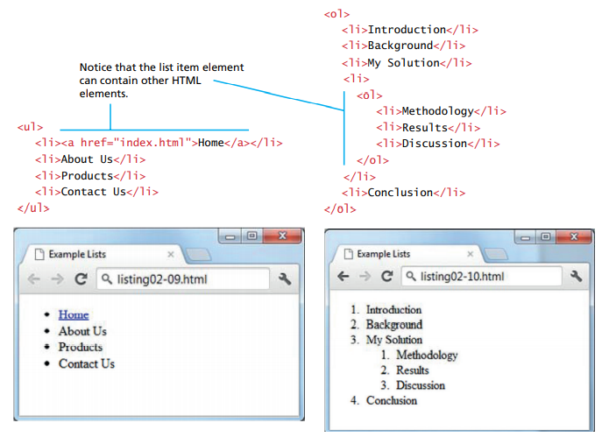
LISTS
Unordered lists are added using the <ul> tag and contain bulletin points.
Ordered lists are added using the <ol> and contain numbers.
The <li> tag is inserted for each item of the list.

Slide 55
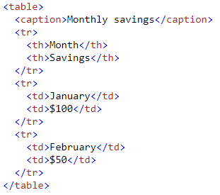
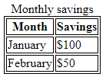
TABLES
Tables consists of rows and columns.
All rows are defined with <tr> but the header column is defined with <th> and the content column is defined with <td>.
The whole table must be wrapped around a <table> tag.
A caption tag can also be added with a <caption> tag. Adding captions is relatively rare.

Slide 56
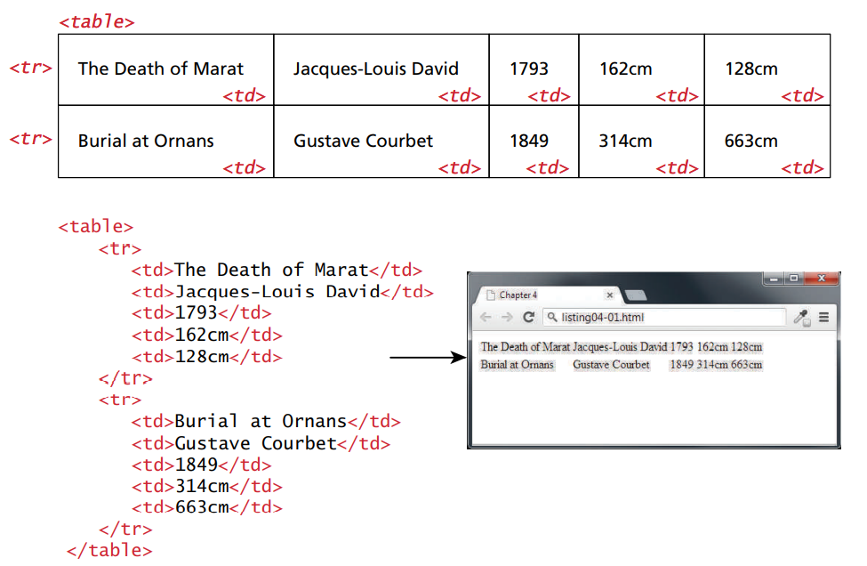
TABLE WITHOUT HEADINGS

Slide 57
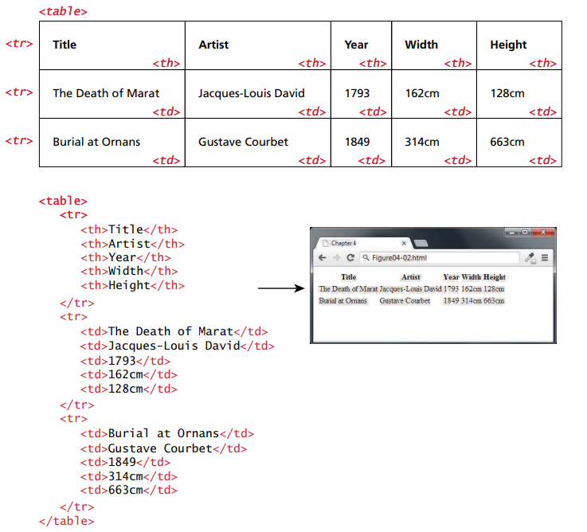
TABLE WITH HEADINGS

Slide 58
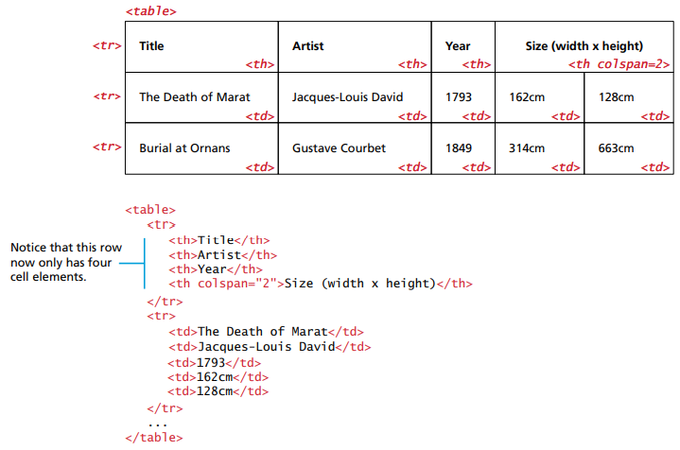
MERGING COLS

Slide 59
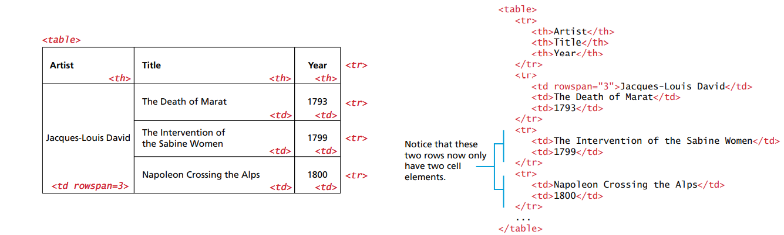
MERGING ROWS

Slide 60
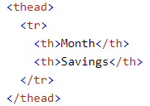
THEAD AND TBODY
Although not required, it is common practice to wrap the header row in a <thead> tag and the content row(s) in a <tbody> tag.
Although these are not necessary and results often look the same without them, it is good practice to include them because they perform better on standard table functions like scrolling, sorting, and DOM manipulation.

Slide 61
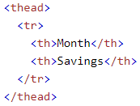
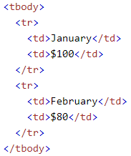
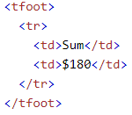
THEAD AND TBODY

Slide 62

THEAD AND TBODY

Slide 63

USING TABLES AS LAYOUTS

Slide 64
DATA TABLES
On occasion, developers need more function than regular HTML tables, they need data tables.
Data tables can sort columns and drag and drop cells to new locations.
The code gets quite complicated on data tables that is why it is common to import libraries such as ag-grid or vuetify.

Slide 65

MEDIA
Media on the web is images, sound, music, videos, movies, and animations.
Common file formats include .wav, .mp3, .mp4, .mpg, .wmv, and .avi.

Slide 66
COLOR
Web sites need a way to display color to display media properly.
Colors can be represented using RGB, CMYK, and HSL.
Colors should never be chosen at random when designing a website.

Slide 67
MEDIA

Slide 68

RGB VS CMYK
RGB is used by computer monitors because the full spectrum of colors using lights can be presented with the red green and blue colors.
CMYK is used by computer monitors because the full spectrum of colors using printers can be presented with the cyan, magenta, and yellow colors.
Printed photos will rarely look the same as photos on screen, because RGB and CMYK have different color gamuts, i.e. different range of colors to display.

Slide 69


RGB

Slide 70

CMYK

Slide 71

HSL
HSL uses hue, saturation, and lightness to represent colors.
HSL was mainly invented because it closely relates to how we describe colors in the real world. We often describe colors as ‘a bright rich green’, instead of ‘a #33CA8F’ color.

Slide 72

OPACITY
Opacity describes the transparency of a color.
It typically is a number between 0 and 1, 1 having zero transparency.

Slide 73

COLOR SYNTAX

Slide 74

COLOR WHEEL

Slide 75


COLOR WHEEL

Slide 76


COLOR TOOLS

Slide 77

COLOR DEPTH
Color depth is used to describe the number of colors a pixel can display.
The larger the depth, the more colors it can describe.
Image color depth, can be limited by device color depth, which can be limited by video card color depth but nowadays those are no longer issues.

Slide 78

COLOR DEPTH

Slide 79

COLOR DEPTH

Slide 80

RESIZING
Resizing an image will always degrade it’s quality, because the program has to interpolate or re-calculate the location of colors on each pixel.
Enlarging an image reduces quality much more than shrinking.
For this reason it is always best to keep large resolutions of original images.

Slide 81

RESIZING

Slide 82

PIXELS VS HAFTONES
Images on a computer screen are displayed with colored pixels.
Images on printed paper are displayed on overlapping dots called haftones.

Slide 83
RASTER VS VECTOR
Images are digitized into 0s and 1s so that they can be stored and retrieved easily from a database.
Images can either be raster or vector type.
A raster image has a collection of hard-coded colored squares/pixels with an assigned number to it. They can be edited using MS Paint, GIMP, and Apple Aperture.
A vector image is not composed of pixels, but instead of objects such as lines, circles, bezier curves, and polygons. They can be edited using Illustrator, Visio, or Flash.
The main advantage of vector is that they are resolution independent but the main advantage of raster is that they display photos better.

Slide 84


RASTER VS VECTOR

Slide 85

JPEG
Joint photographic experts group(JPG) is a 24-bit, true-color file format ideal for photos.
It uses a sophisticated compression scheme that can dramatically reduce file size.

Slide 86

JPEG
JPEG is a lossy compression, meaning it reduces file size by eliminating information on each save.

Slide 87
GIF
Graphic Interchange Format(GIF) was the first image format supported by browsers and are 8-bit.
GIFs use simpler compressions that are lossless, which means no pixel information is lost.

Slide 88

PNG
Portal Network Graphics(PNG) were developed in the 1990s and use lossless compression.
PNG not only has one of the best size to quality ratio but also a transparency map that can be used for compositing.

Slide 89

SVG
Scalable Vector Graphics(SVG) are vector format images that are used by my many browsers.
Vector images tend to look cartoony, but have been very popular nowadays.
They are created in XML format and can be edited using a text editor.

Slide 90
VIDEO
videos can be added using the <video> tag.
The ‘controls’ attribute adds video controls, like play, pause, and volume.
The ‘autoplay’ attribute plays the video automatically on start.
The ‘muted’ attribute plays the video muted by default.
The ‘loop’ attribute replays the video over and over again.
The width and height attributes set the size of the video. The page may flicker if those are not set.
The source element is used to define the location attributes of the video.
The text between the <video> tags will only display in browsers that do not support the video element.

Slide 91


VIDEO BROWSER SUPPORT

Slide 92


VIDEO

Slide 93

AUDIO
Similar to the video syntax, audio can be added using the <audio> tag.
The controls attribute adds controls like play, pause, and volume.
The <source> element specifies a list of links that the browser can use to play the audio. The browser will start with the top link first.
The text between the <audio> tags will only display if the browsers do not support the <audio> element.
The autoplay and muted attributes work just like the video attributes.

Slide 94

AUDIO BROWSER SUPPORT

Slide 95
OBJECT
The <object> tag is used to import any generic media item.
These items can include java applets, pdf readers, or flash players.
The <embed> tag can be used to import HTML into another HTML document.

Slide 96

CANVAS
The final media element in HTML is the <canvas> tag.
Canvas is used to draw 2 dimensional shapes on the browser.
Canvas is very powerful, and has the ability to draw and animate all sorts of designs.

Slide 97
DESIGN CONSIDERATIONS

Slide 98

MOCKUPS
It takes a long time to code a graphical user interface(GUI).
Many developers often get sucked into their own rabbit holes spending weeks on a GUI and realize later that the customer wanted it another way.
This is why it’s very important to first create mockups and get the green light from the customer before spending any time on coding.
A mockup is a preliminary image that conceptualizes how the final application will look like.
There are many online tools to create mockups quickly, but simple image editors can also do the trick.

Slide 99

PIG LATIN
Pig Latin is often used in prototyping web sites to fill space with text that looks somewhat readable and see how a website would look like.
Essentially, it transfers the initial consonant or consonant cluster of each word to the end of the word and adds ‘ay’ at the end.

Slide 100

RESPONSIVE DESIGN
Responsive design is about creating web pages that automatically adjust to different screen sizes.
An easy way to test this is by going on the dev tools of the web browser and clicking on toggle device toolbar.

Slide 101

RESPONSIVE DESIGN

Slide 102

COMPATIBILITY
As in all web development, all html syntax must be tested on all browsers that the company claims to support.
This is a very important step, because some features may only work on 3 of the 4 browsers, and the syntax needs to be adjusted to work on all 4.
In some cases, an entire re-write can be required just to make it work on one browser #IE.

Slide 103
ACCESSIBILITY
Accessibility provides the user a good way to navigate throughout your website.
Accessibility and semantics often go hand and hand. Sementic design is the idea of using the right tags for the right job as shown in the example below.
Semantic HTML allows browsers for screen reader identifications, focusing, and clicking. Semantic tags includes <form>,<table>, and <article>.
Sementic design is not necessarily approved by all developers. Some might argue that a lot of sementic markups causes a page to be more difficult for modification.

Slide 104

KEEP A CLEAN OUTLINE
When coding, it’s important to stay organized, and maintain a clean outline.
Take advantage of carriage returning, indenting, and commenting.

Slide 105
SEO (SEARCH ENGINE OPTIMIZATION)
SEO is a way to optimize your website so that it receives more clicks on a search engine like Google or Bing.
It can be achieved 2 ways, using on-site and off-site.
Off-site examples might be advertising your website on social media.
On-site might be using certain html meta tags, or key terms that show up frequently on a search engine.
There are many documents online showing ways to improve your SEO.

